Slide 1

Library Controlled Additional ID
for Hold Requests
CERV Enhancement (ID# 8777)
Yoel Kortick | June 2026

Slide 2
Agenda
  Introduction
  Defining the additional ID for hold requests
  Examples using this development
  Viewing the additional ID for hold requests

Slide 3
Introduction

Slide 4

Introduction

Slide 5
Introduction
With this development libraries can control how the additional ID assigned to hold requests will get created.
This creates more flexibility for libraries, enabling them to set this ID to better reflect library hold request management processes.
When this feature is not used (and until this feature was developed) an additional ID is generated based on the internally managed sequence (Request ID).
Once the user enables the new sequence (Fulfillment configuration menu > Physical Fulfillment > Request Additional ID Configuration), the fields will be generated using the new functionality.

Slide 6
Defining the additional ID for hold requests

Slide 7
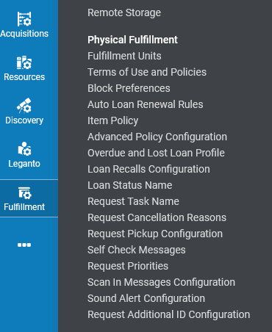
Defining the additional ID for hold requests
See also Configuring the Request Additional ID.
We will define the Request Additional ID at "Configuration > Fulfillment > Physical Fulfillment > Request Additional ID Configuration"

Slide 8
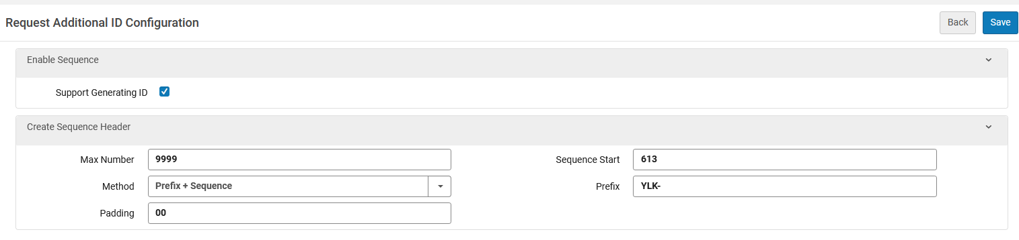
Defining the additional ID for hold requests
Here are our definitions
We checked here so that we can define a customized additional ID for hold requests
The request additional ID will be prefixed with YLK- and then start from after 613
The request additional ID will include both the prefix and the running number

Slide 9
Examples using this development

Slide 10
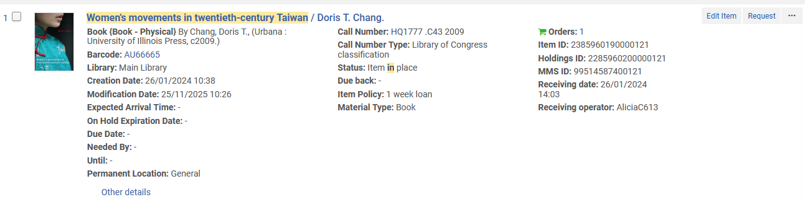
Examples using this development
Now that we have defined the new additional ID for hold requests, we will create some new requests and see how and where the additional ID for hold requests is created.

Slide 11
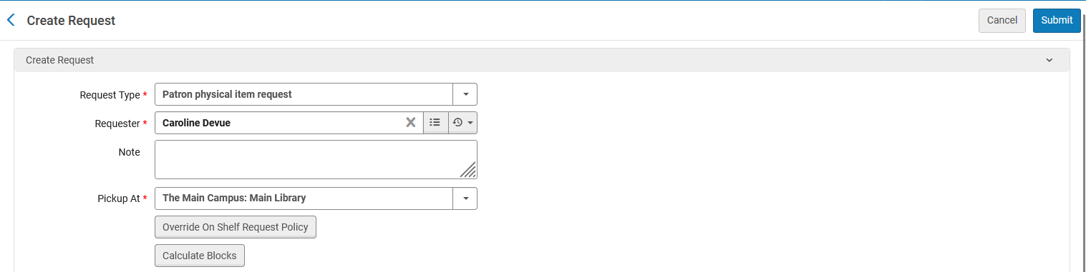
Examples using this development
Now we will submit the request

Slide 12
Viewing the additional ID for hold requests

Slide 13
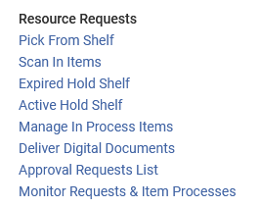
Viewing the additional ID for hold requests
The additional ID for hold requests appears in the following places:
  Pick From Shelf
  Expired Hold Shelf
  Active Hold Shelf

Slide 14
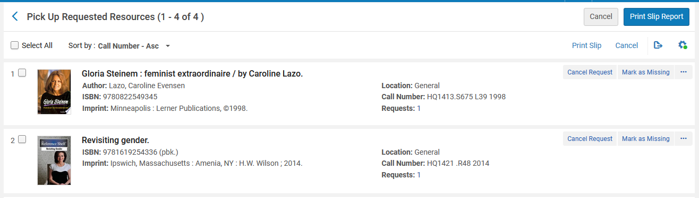
Viewing the additional ID for hold requests
By default, the additional ID for hold requests will not appear there, but it can appear by selecting it to appear from after clicking the cog wheel on the top right of these three pages.

Slide 15
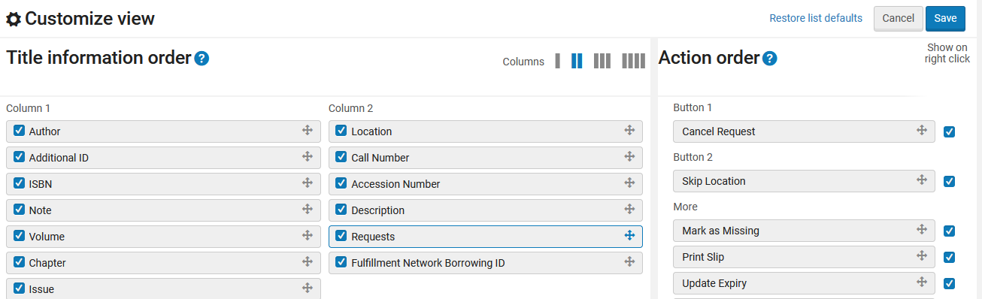
Viewing the additional ID for hold requests
Here we select that we want the Additional ID for hold requests to appear.

Slide 16
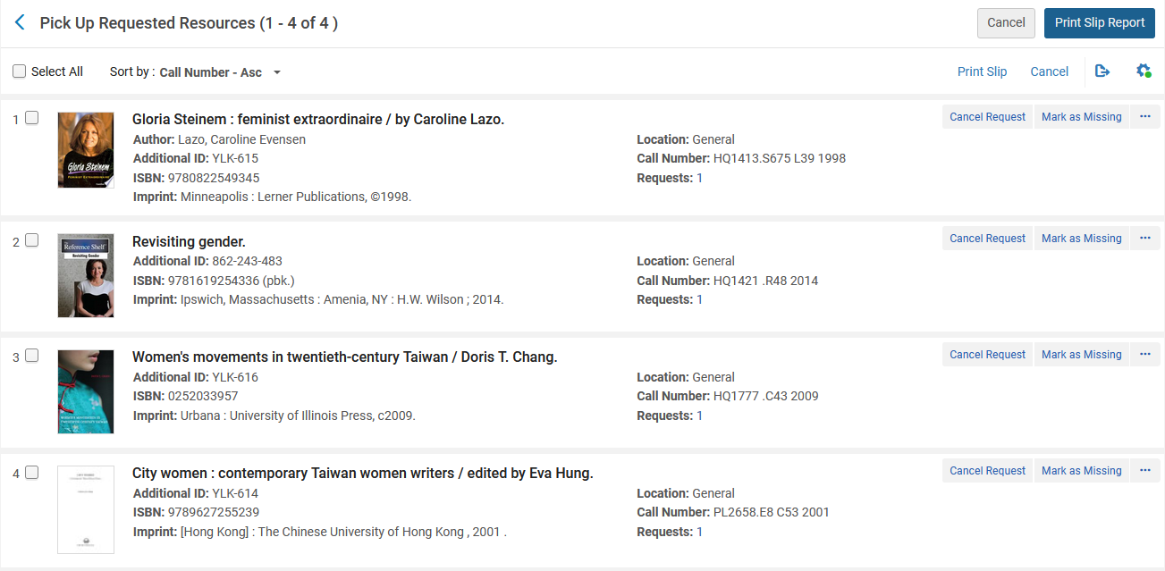
Viewing the additional ID for hold requests
Now we see the additional ID for hold requests
This was created before we defined the customized additional ID and hence it has a default format
These were created after we defined the customized additional ID and hence it has a customized format with a YLK- prefix and a running number starting after 613

Slide 17
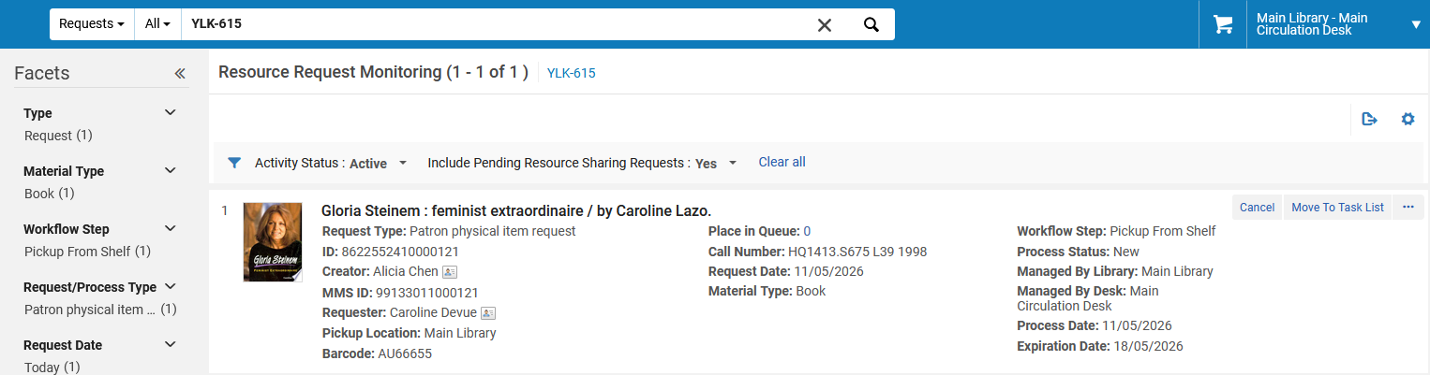
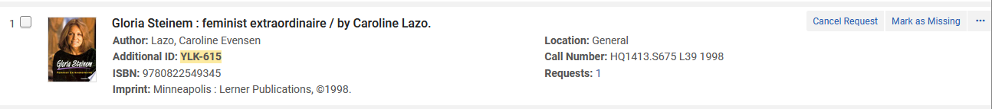
Viewing the additional ID for hold requests
Note that it is also possible to retrieve requests according to the additional ID for hold requests

